Slide 1

Semester Project – I
“RCPIT College Query Chatbot”
By
Soham Kailas Borole (PRN: 25110815 & Roll No:14)
Shubham Rajendra Kumavat (PRN : 25110825 & Roll No. : 22)
Jidnyesha Bharat Patil (PRN : 251108041 & Roll No: 38)
Sneha Manoj Barade (PRN: 25110857 & Roll No: 50)
Under the Guidance of
Prof. Prathmesh Mahajan
Department of Artificial Intelligence and Data Science
The Shirpur Education Society’s
R. C. Patel Institute of Technology, Shirpur - 425405.
[2026-27]

Slide 2

Outline:
Project Title & Team Introduction
Domain Overview
Problem Statement
Literature Survey
Comparative Analysis
Proposed Methodology
Software and Hardware Requirements
Timeline / Gantt Chart
Conclusion and Future Scope
References

Slide 3
Project Title & Team Introduction:
Project Title : RCPIT College Query Chatbot
Team Member :-
1. Shubham Rajendra Kumavat (Roll No: 22)
2. Jidnyesha Bharat Patil ( Roll No: 38)
3. Sneha Manoj Barade ( Roll No: 50)
4. Soham Kailas Borole (Roll No:14)
Department: Artificial Intelligence & Data Science
Class: SY B.Tech – AIDS
Academic Year: 2026–27

Slide 4
Domain Overview:
INFORMATION AREAS
Artificial Intelligence and Chatbots :
Artificial Intelligence enables systems to perform intelligent tasks.
Chatbots interact with users through questions and answers.
NLP helps systems understand human-language queries.
Chatbots can provide quick responses to common questions.
Our project applies this idea to RCPIT-specific information.
Admission
Courses
Fees & Scholarships
Faculty
Hostel
College Info
Placement
FAQs
Contacts
Facilities
Navigation
CAP Information
EXAMPLE QUERY: What are the available B.Tech courses?
CHATBOT RESPONSE: RCPIT offers B.Tech programs across multiple engineering disciplines.

Slide 5
Problem Statement:
Students and visitors may need to search different sources or contact different departments to obtain college-related information.
BEFORE
CURRENT DIFFICULTIES
Student → Website → Pages
→ Documents → Staff
Information is distributed across different sources
Finding specific information can take time.
Students may search multiple pages or documents.
Basic queries may depend on staff availability.
No single conversational interface covers many college topics.
MAIN OBJECTIVE: Provide quick, simple and centralized
access to RCPIT college information through a chatbot interface.
.
PROPOSED
Student →
RCPIT College Query Chatbot
→ Relevant Information

Slide 6

Literature Survey:
Initial study of chatbot and question-answering approaches
AI Chatbot
College Information Systems
Student-Support Chatbots
Quick automated responses
Centralized student support
FAQ and quaery handling
NLP
Question Answering
Knowledge Bases
Natural-language query understanding
Mapping questions to useful answers
Domain-specific information storage

Slide 7
Research Gap
General AI chatbots may not always provide college-specific or verified information. A dedicated RCPIT Knowledge Base can organize frequently required information in one place.
Key Findings
• Centralized information improves accessibility.
• NLP supports natural-language questions.
• Domain-specific knowledge can improve relevance.

Slide 8
Comparative Analysis:
Feature
Traditional
FAQ Chatbot
General AI
RCPIT Chatbot
College-specific information
Limited
Limited
Not guaranteed
Yes
Centralized RCPIT information
No
Limited
No
Yes
Admission / Fees
Manual search
Limited
Possible
Yes
Faculty / Placement
Manual search
Limited
Possible
Yes
Navigation
Manual
No
Limited
Planned
Natural-language questions
No
Limited
Yes
Planned
Information source
Multiple sources
Predefined FAQs
General knowledge
RCPIT Knowledge Base

Slide 9
Proposed Methodology:
Work Flow Diagram
Student
Chatbot Interface
User
Query
Flask Backend
Query Processing
Knowledge Base Search
Relevant Information
Response
AI / NLP — PLANNED
Query
understanding
Knowledge Base Modules
College Overview
Departments
Faculty
Admission
Fees
Hostel
Placement
Facilities
Navigation
Contacts
CAP
FAQs

Slide 10
Software and Hardware Requirements
Software Hardware
Operating System: Windows / Compatible OS 1 . Laptop / Desktop Computer
IDE: Visual Studio Code 2. Minimum 4 GB RAM recommended
Programming Language: Python 3. Adequate storage
Backend Framework: Flask 4. Standard display
Frontend: HTML, CSS, JavaScript 5. Keyboard and mouse
Database: SQLite — Planned 6. Internet connection
AI/NLP: Planned
Git/GitHub: Planned

Slide 11
Timeline / Gantt Chart:
Work Done | week
Topic discussion and finalization Problem statement and objectives | Week 1
Existing chatbot study Requirement analysis System workflow and architecture planning | Week 2
RCPIT information collection Knowledge Base preparation College, department, faculty, admission, fees, facilities and placement information organization | Week 3
Basic webpage development Frontend-backend connection | Week 4
Completed :
Week 1-4
Current :
Knowledge Base Integration +
Fronted Prototype
Current Progress :
Approximately 30%

Slide 12

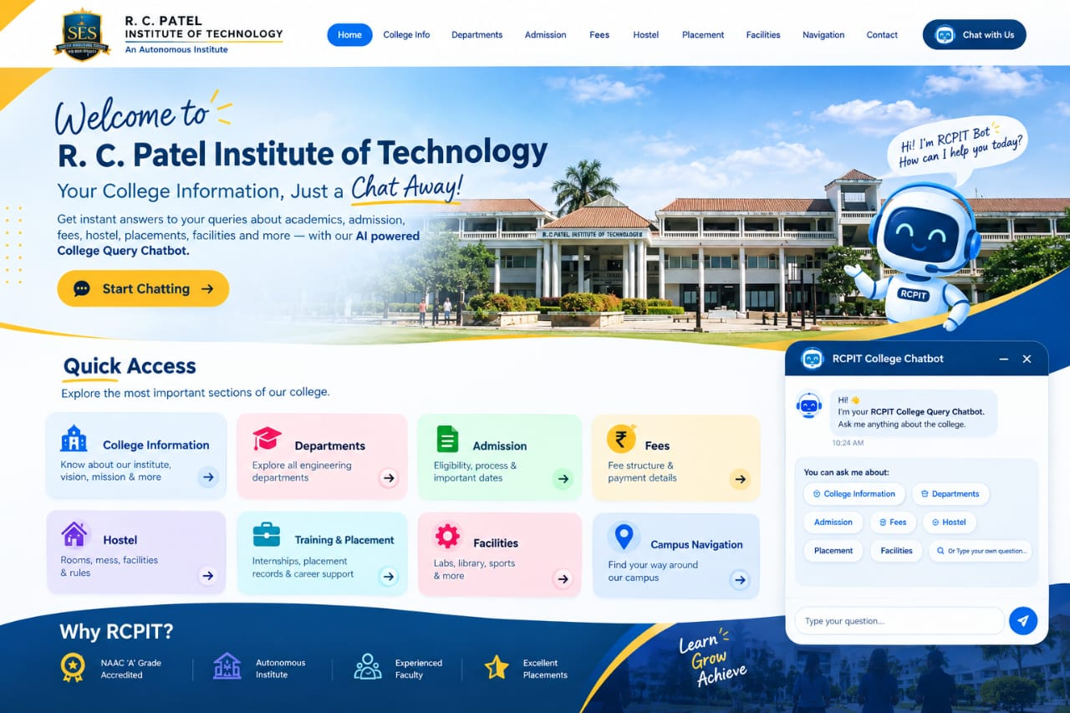
Fronted view:

Slide 13
Future Scope:
1. AI/NLP-based question understanding
2. Knowledge Base search
3. Database integration
4. Voice-based queries
5. Google Maps-based navigation
6 . Admin dashboard
7. Live notices and updates
8. CAP/admission information updates
9. Multilingual support
10. Mobile-friendly interface
11. Improved answer accuracy

Slide 14
Conclusion:
Conclusion
The problem of finding RCPIT information quickly was identified.
A structured RCPIT Knowledge Base has been prepared.
Basic Flask backend has been developed.
A basic chatbot webpage has been created.
Frontend and backend communication has been successfully tested.
The project has reached approximately 30% progress.
The next major step is to connect the Knowledge Base with the backend and implement question searching.

Slide 15
References:
Official and technical documentation sources
R. C. Patel Institute of Technology, Shirpur
All India Council for Technical Education (AICTE)
Maharashtra State CET Cell
Dr. Babasaheb Ambedkar Technological University (DBATU)
Python Documentation
https://www.rcpit.ac.in/
https://www.aicte-india.org/
https://cetcell.mahacet.org/
https://dbatu.ac.in/
https://docs.python.org/

